Slide 1
Passenger entrance recommendation engine
Client:
Metis, New York
09.28.2018
Emma Huang, Rob Murray-Rust, Brendon Happ, Krisztian Sandor

Slide 2
Subway passengers are wasting time on their commute and we can help Citymapper users to save time
What is the problem?
How we can help you?
Riders are…
…not aware of the hidden entrances
Timesaving for your users…
…not avoiding bottlenecks at two-way turnstiles
…hence more users for you!
…not sure how to avoid entrance delays due to weather effects

Slide 3
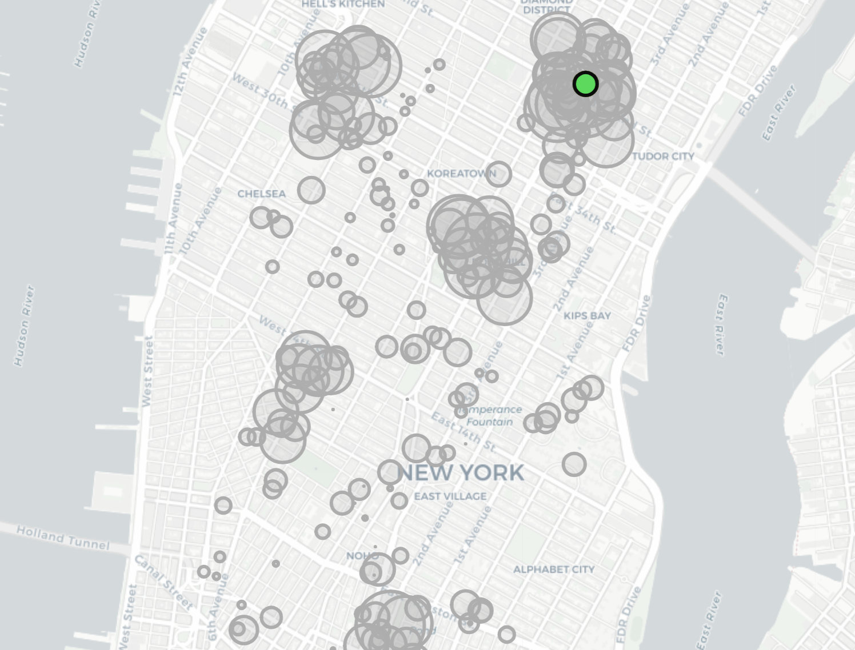
Multiple stations have huge commute traffic, hence substantial optimization potential
Some stations are more affected by commute traffic than others…
… for clarity we will explain our concept via Grand Central station
Why Grand Central?
Entrances on multiple streets
Has ‘hidden’ entrances
Has huge commute traffic
Shows strong directional effect
Grand Central St.
All other stations
Total foot traffic per day
Source: please see appendix

Slide 4
We can systematically recommend the best entrance for each subway station
Grand Central Station
Entrances have a wide range of passenger distribution..
Source: please see appendix

Slide 5
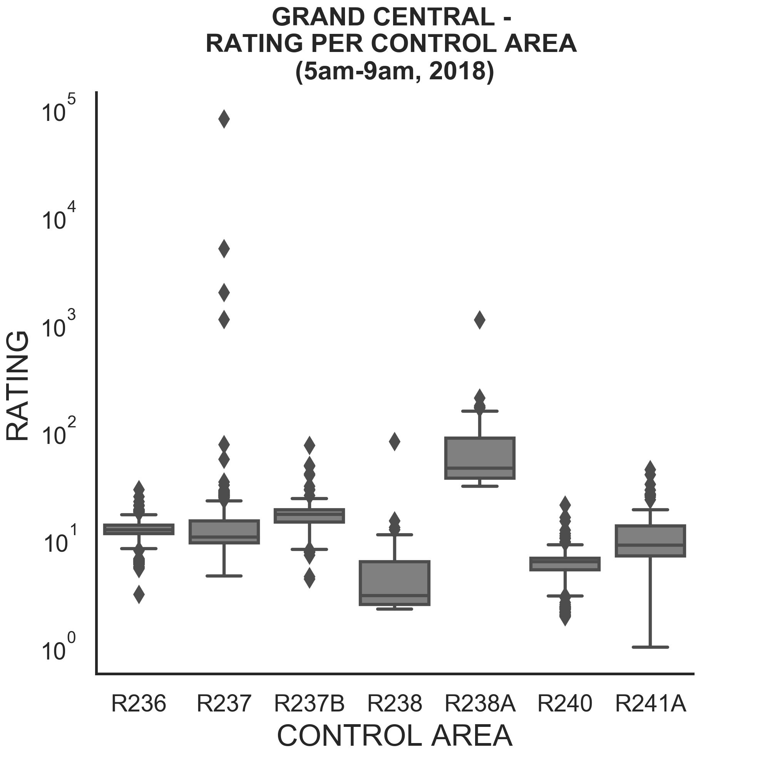
We can systematically recommend the best entrance for each subway station
Grand Central Station
…creating opportunities for optimizing foot traffic
Entrances have a wide range of passenger distribution..
R238A is the consistent best entrance
Source: please see appendix

Slide 6
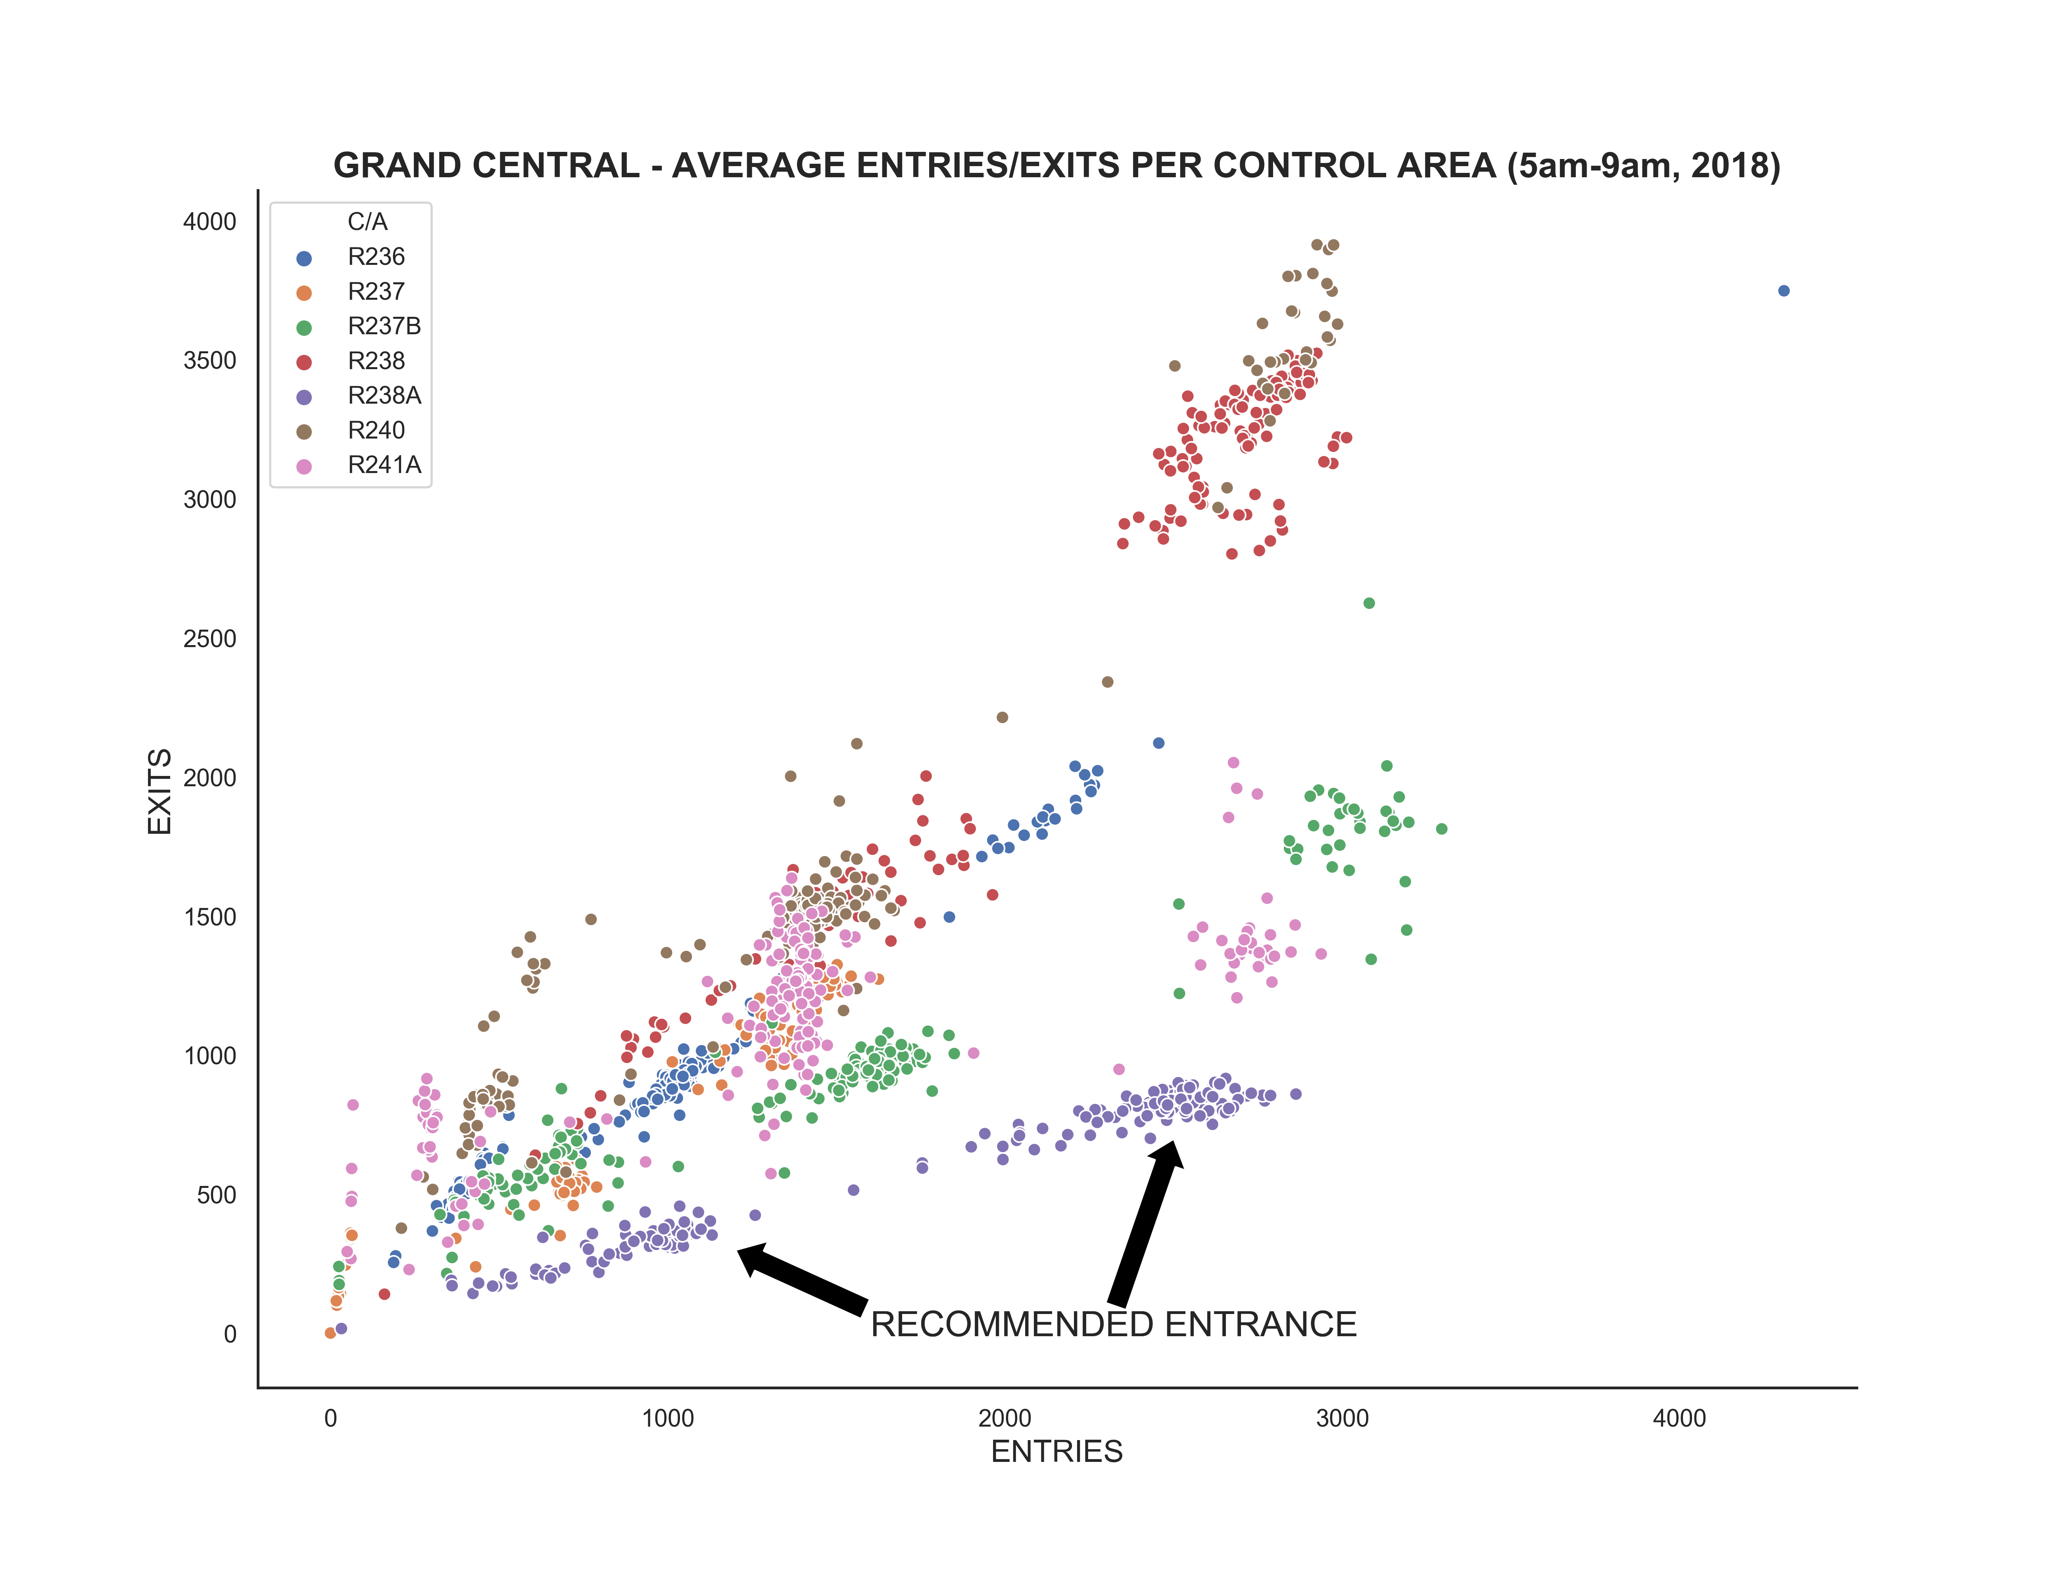
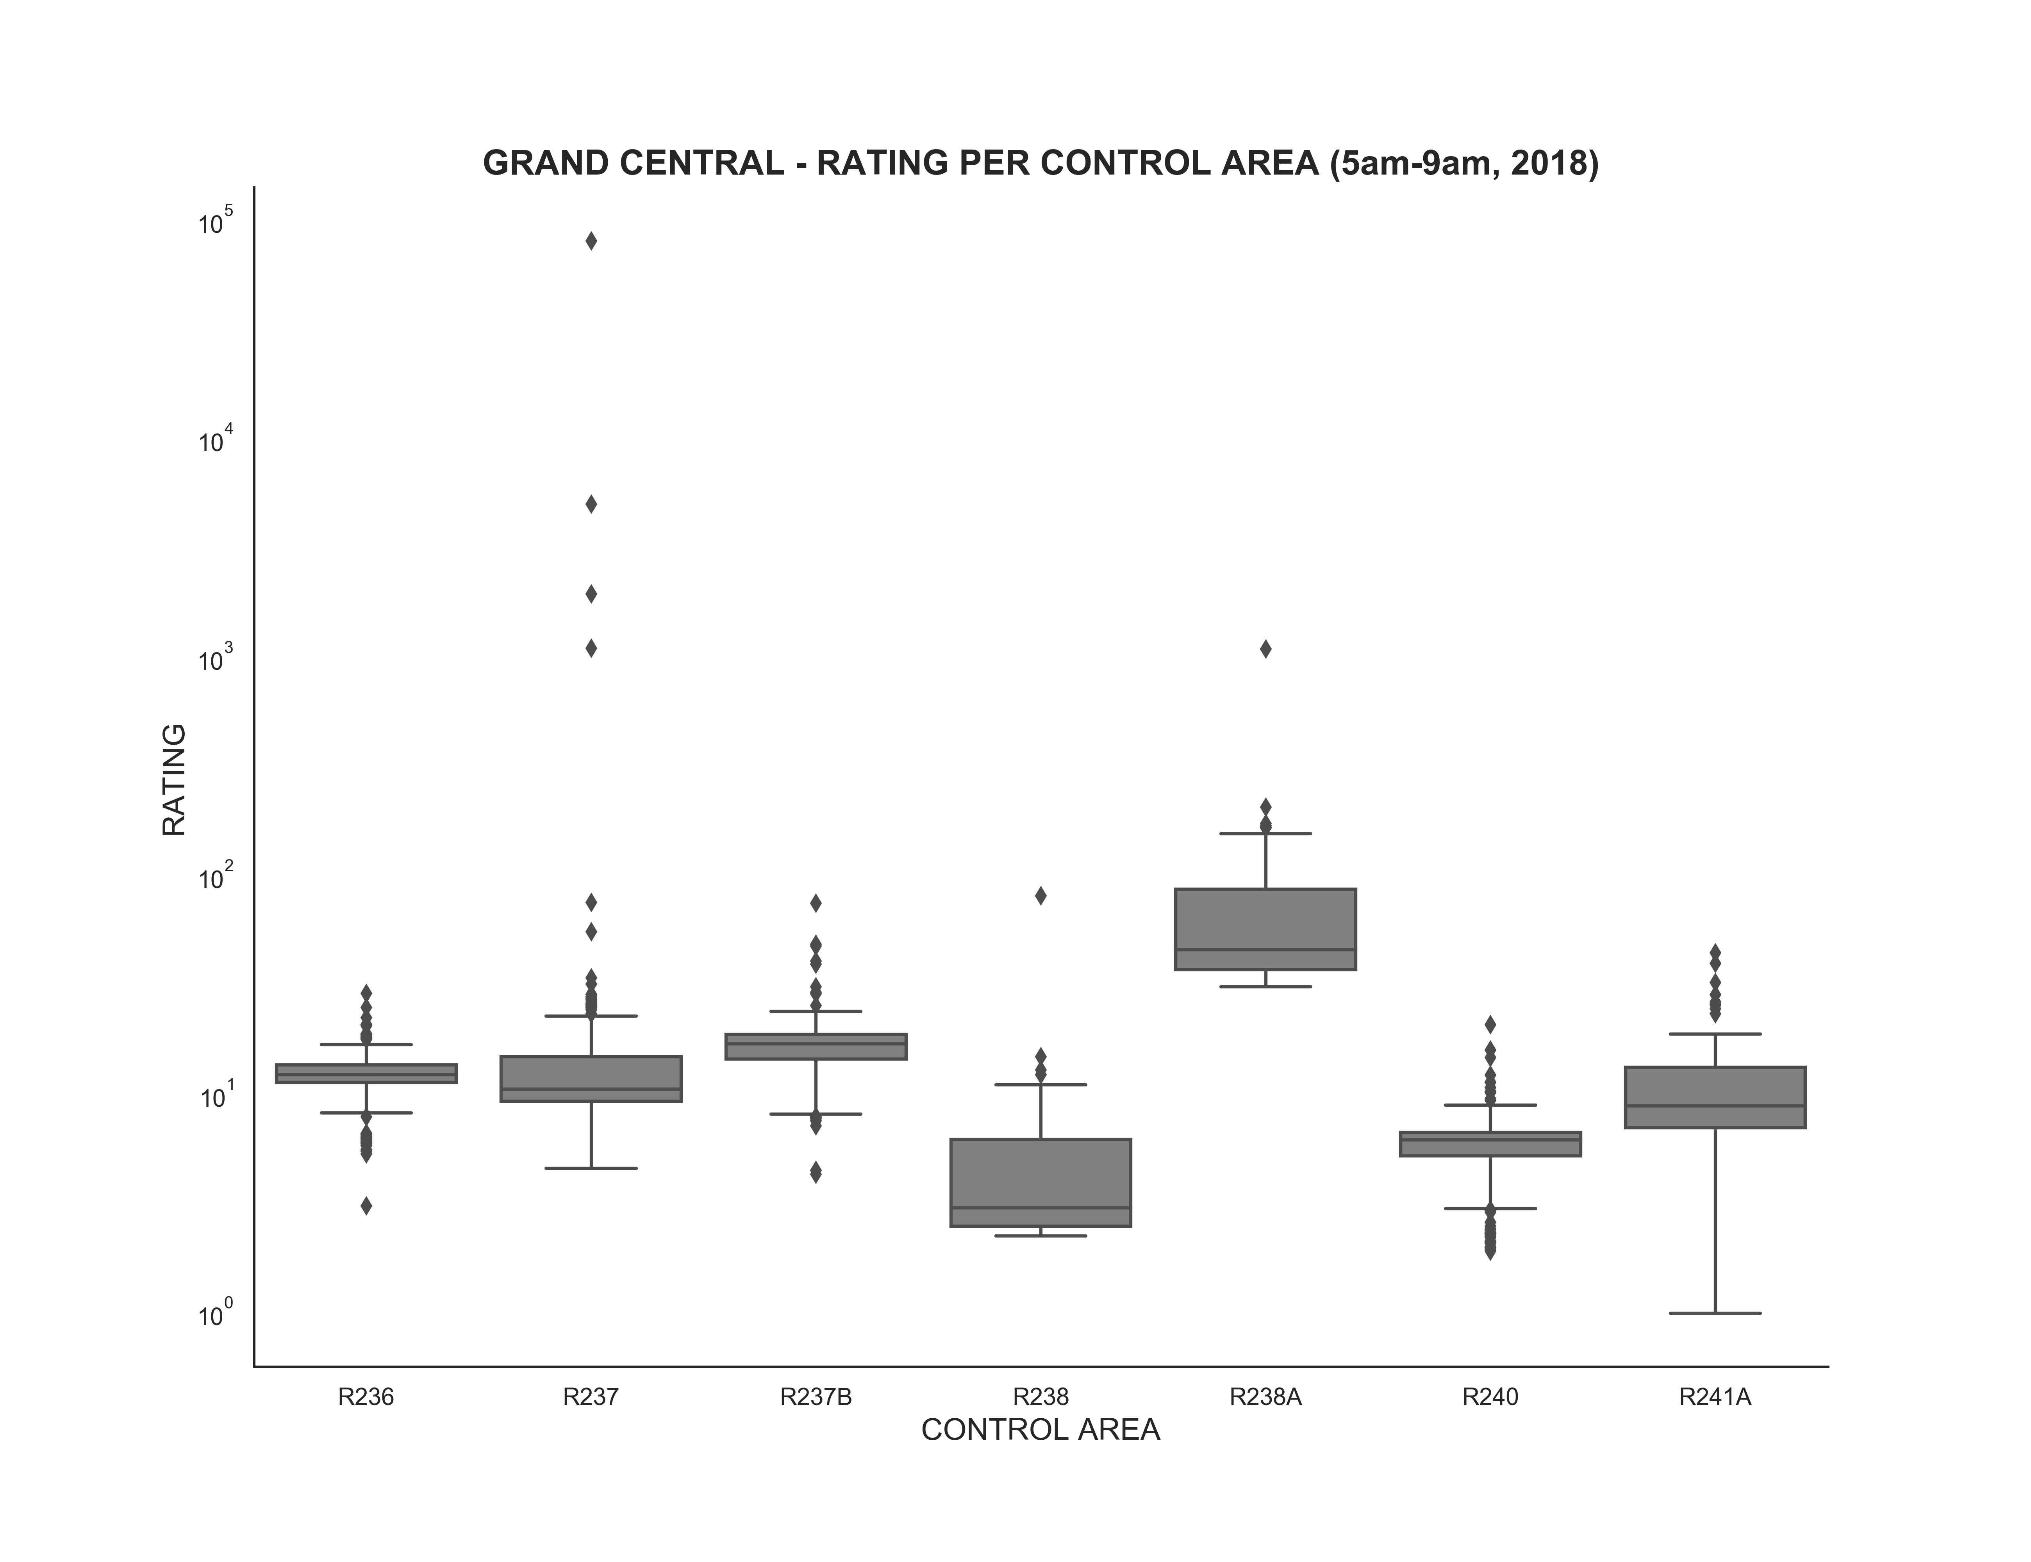
Our recommendation engine weights entry and exit trends into a single entrance rating
Grand Central Station
Strong connection between entries and exits reveal the traffic trends…
…our rating formula weights the trends and reveals the best entrances
R238A is the consistent best entrance
Source: please see appendix

Slide 7
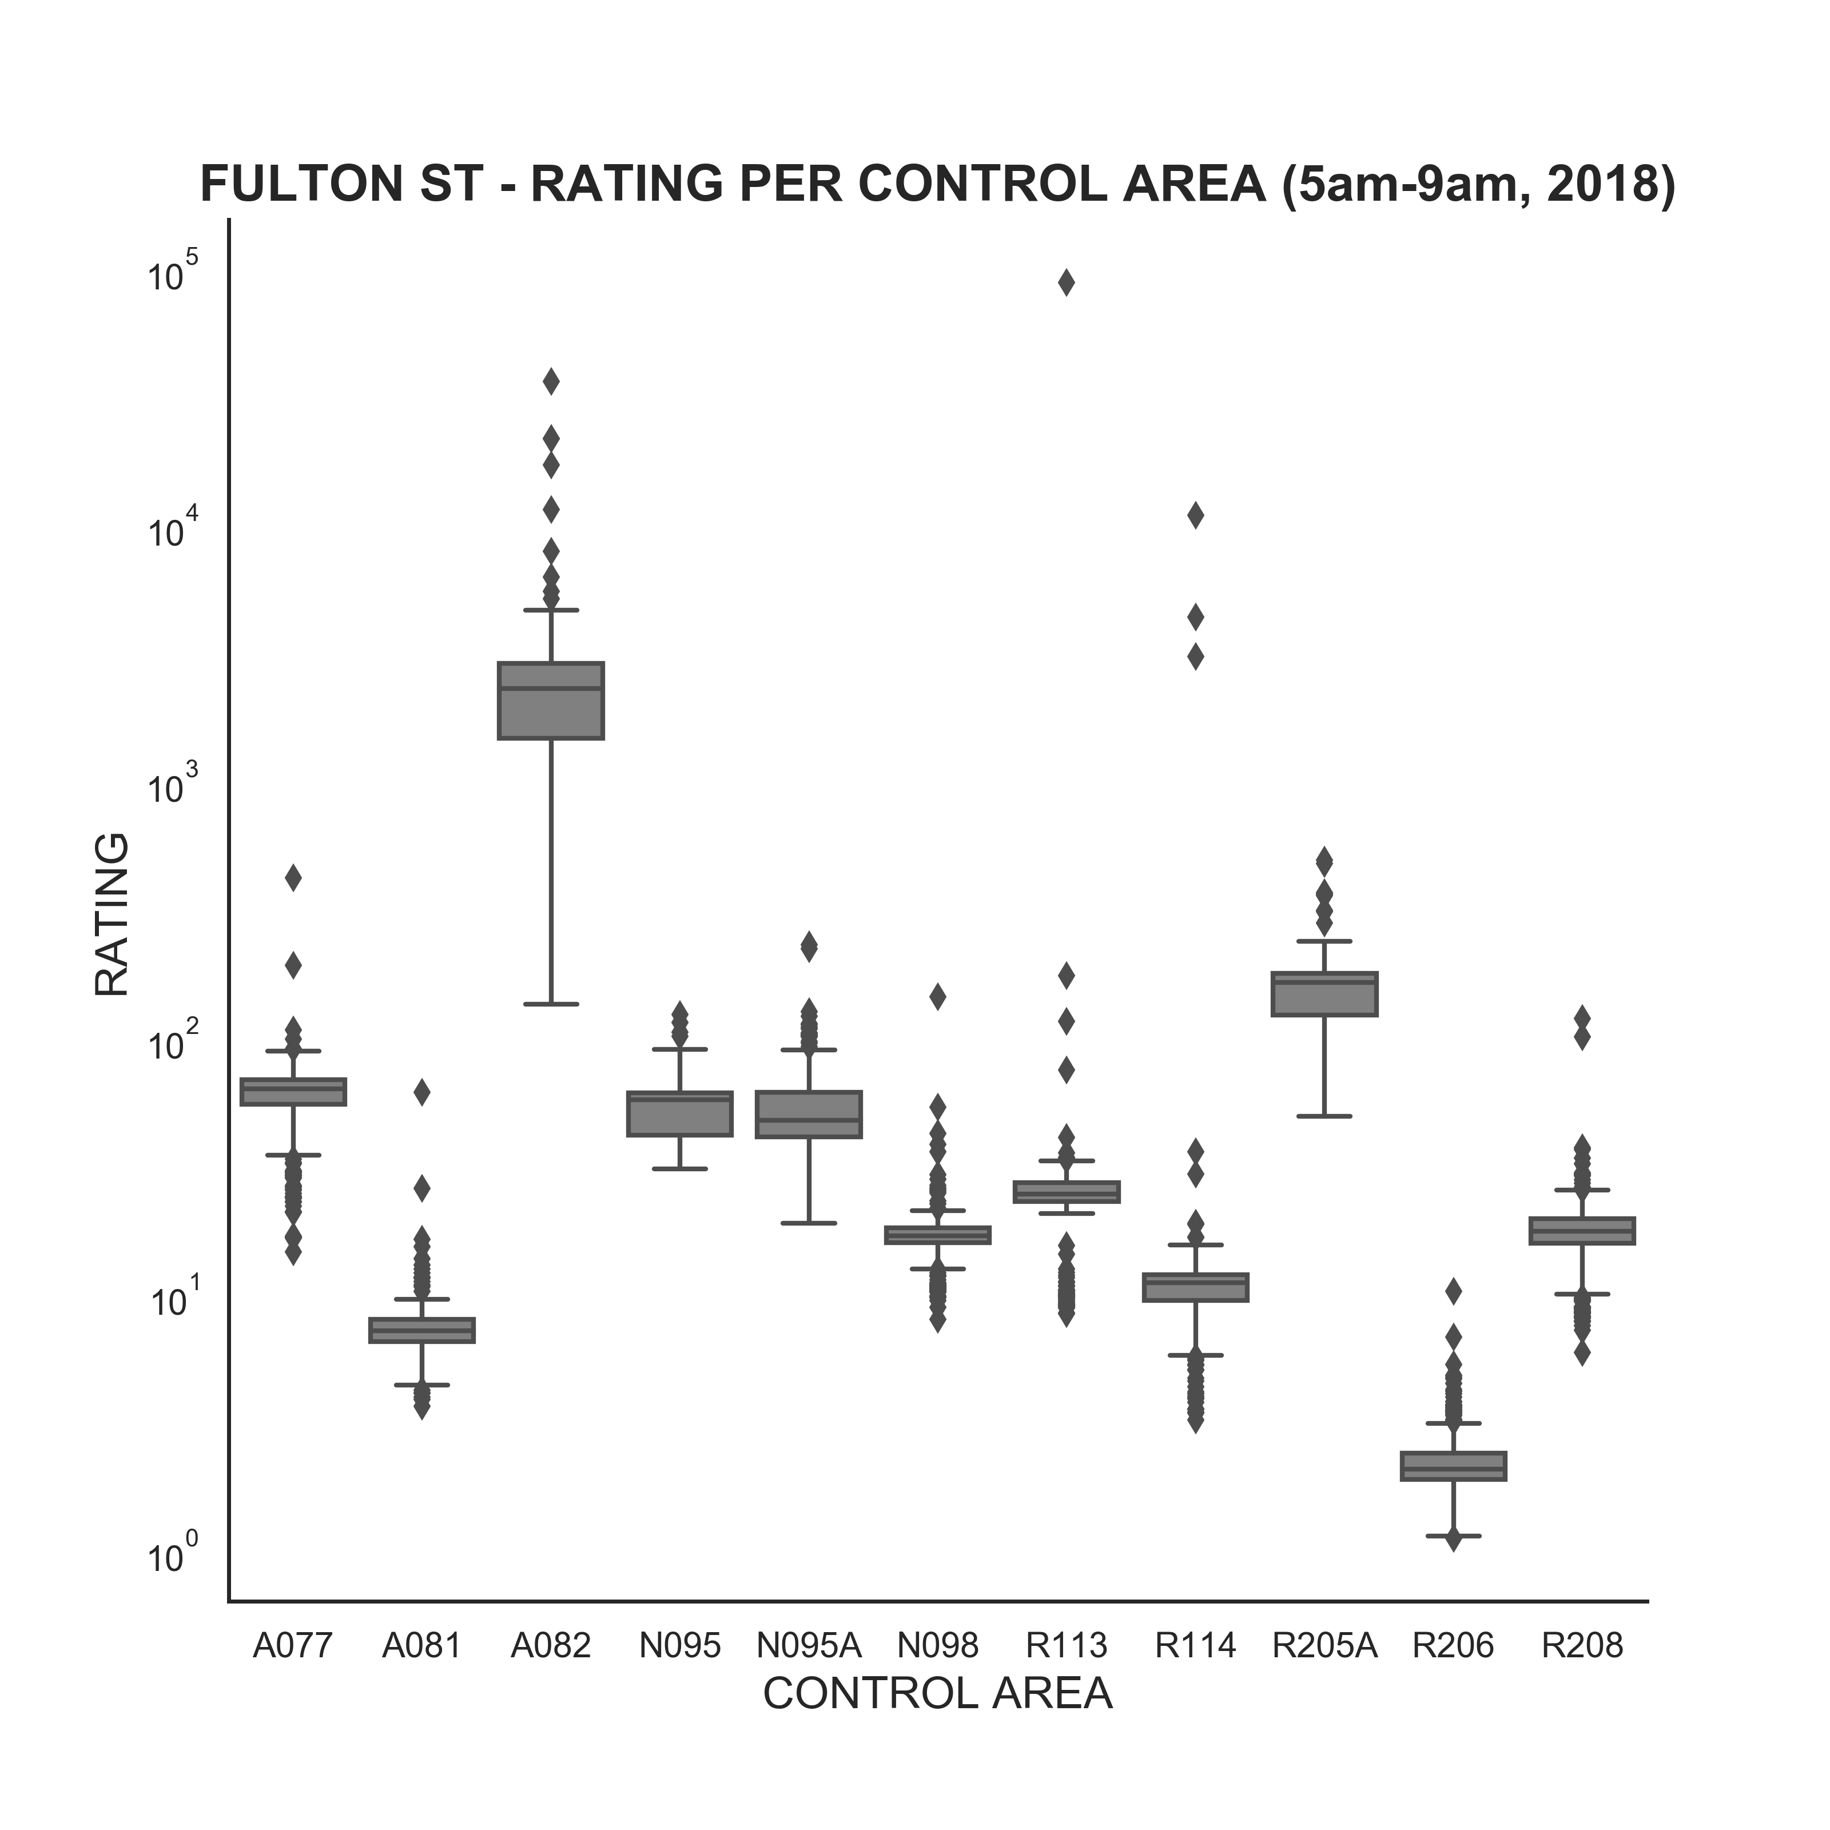
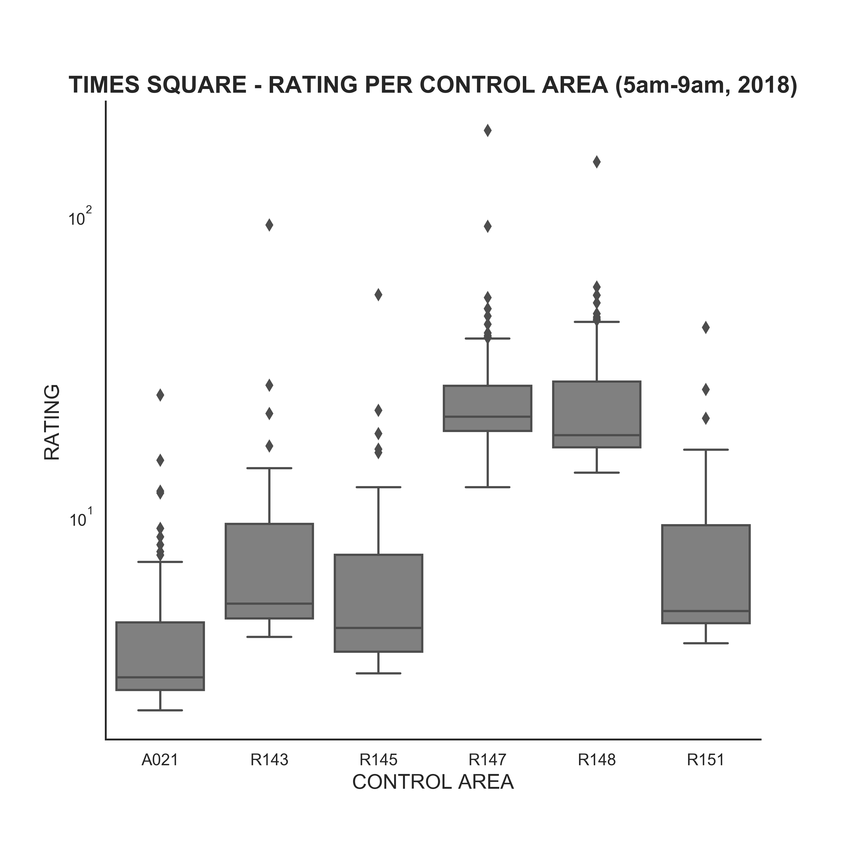
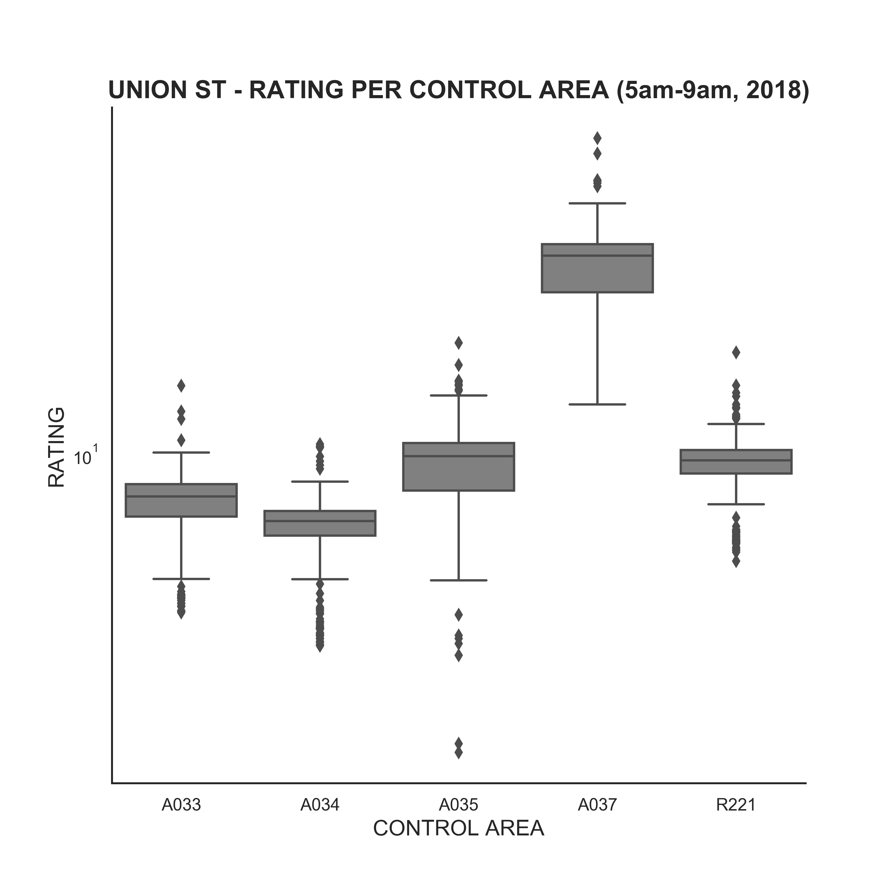
The rating is able to recommend the best entrances consistently for every major station
Fulton Street, Times Square and Union Street stations
Best entrance
Best entrance(s)
Best entrance
Source: please see appendix

Slide 8
As a next step we propose the analysis of rainy weather on the entrance recommendation
Grand Central Station
Grand Central station shows varying rain-effects on the rating
Best entrance gets even better
Worst entrance gets even worse
Source: please see appendix

Slide 9
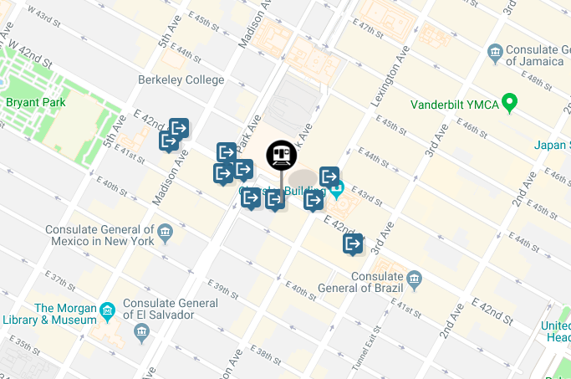
We can help you integrate the best entrance recommendation into the application?
Grand Central Station
The best entrance is only 1 block away from the closest entrance
Source: please see appendix

Slide 10
We can help you integrate the best entrance recommendation into the application?
Grand Central Station
The best entrance is only 1 block away from the closest entrance
Citymapper bot:
Would you like to switch to the best entrance?
Source: please see appendix

Slide 11
APPENDIX

Slide 12
We followed a thorough methodology to define the recommendation engine
Our steps in the analysis
Datasets used
Used the full year 2018 MTA turnstile dataset, with the following assumptions:
AM commute hours [5am – 12pm)
PM commute hours [4pm – 11pm)
Rain threshold 0.5in
Cleaned the dataset from data issues, e.g.
Turnstile counters occasionally resetting to 0
Turnstiles counting backwards and occasionally turning negative
Turnstile counters exceeding 20,000 passengers entries per day
Included noaa.gov data for Central Park precipitation to analyze weather effects on turnstile traffic
Calculated station entrance recommendation index based on our proprietary formula: (# Entries/# Exits)² / (# Entries)
MTA turnstile dataset (http://mta.info/developers/turnstile.html)
NOAA.GOV weather data (https://www.ncdc.noaa.gov/cdo-web/datasets/GHCND/stations/GHCND:USW00094728/detail)
Google images (including those about Citymapper, http://citymapper.com/)

